Slide 1
Intro to Inquiry
Allegheny County Library Association
Librarians as STEM Educators

Slide 2
Discrepant Event
What do you see or observe?
Does it make sense?
Why is the event happening?
Can you explain the science?
Notes:
[COURTNEY]
What is a discrepant event?
It is a “puzzling” happening or surprising/unexpected event that a child can’t quite figure out. The purpose of a discrepant event is to generate “wonderment” or cause the observer to “wonder why” the event occurred as it did. The point is to get the attention of the observer, provoke their thoughts, and initiate inquiry by the observer. A learner will only want to learn when they have a need to figure out “why” an event occurred the way it did. A discrepant event can be done on anything but the goal is to “upset” the learner’s normal way of thinking or challenge their misconceptions. Most children (and many adults) have significant misconceptions about “why” things scientific events happen. Confronting those concepts is the first step in activating their sense of “wonderment” leading to inquiry.

Slide 3
Discussion
What is inquiry?
Notes:
[CARRIE]

Slide 4
Geology Observation: Definition of Inquiry
Inquiry is an intellectual process in which students develop an understanding of the natural world, driven by observations and questions, formulating and communicating explanations based on evidence.

Slide 5
About the Librarians as STEM Educators: Project Basics
Grant funded by the IMLS
Collaboration between the Allegheny County Library Association and ASSET STEM Education
Notes:
[CARRIE]
Hello, my name is Carrie Lane and I am the youth services coordinator at the Allegheny County Library Association. Before we hear more from the presenters today about inquiry, I’d like to give you some background about the Librarians as STEM Educators project.
According to a study commissioned by the Wallace Foundation, one of the most important strategies to improve the quality of out-of-school-time (OST) programs is “aligning after-school programming with school district curricula to ensure that after-school programs reinforce and/or supplement what children learn during the school day.” Libraries offer OST programs to children of all ages, offering an excellent opportunity for reinforcing those STEM skills taught in school. However, to be effective, librarians need an increased understanding of STEM education and inquiry based instruction and literacy skills in order to adapt their current K-5 programming and/or design and implement new STEM educational programs. This research and need amongst Allegheny County libraries encouraged ACLA to seek funding to support education and instruction. In 2014, ACLA received funding from the Institute for Museum & Library Services to support a three-year project.
ACLA partnered with ASSET STEM Education, a nationally recognized provider of STEM training for teachers, whose staff is translating their expertise for librarians. More than simply replicating STEM programs developed by others, the project required youth services professionals to learn STEM teaching methodology so they could adapt their programs to be inquiry-based and to reinforce STEM concepts taught in school. Project participants learned from ASSET and experimented with new techniques and approaches and are now sharing their experiences with colleagues, hoping to develop a set of best practices for teaching STEM in public libraries.

Slide 6
About the Librarians as STEM: ASSET STEM Education
Leading national science, technology, engineering and math (STEM) education improvement nonprofit
20-year track record of improving teacher and student outcomes
Fosters STEM fluency and college/career-readiness
Provides professional development, hands-on educational materials and consulting services for educators of ALL students
ASSET programs align with national and state educational standards and are results-oriented, research-grounded and inquiry-based
Notes:
[CARRIE]

Slide 7
About the Librarians as STEM: Mission-Focused Innovation at ASSET STEM Education
Mission: To advance teaching and learning to engage, inspire and empower all learners.
Vision: ASSET STEM Education will continue to be the premier provider of services to systemically improve education by equipping educators with effective tools and strategies to create innovative and relevant learning environments so all students acquire the knowledge and skills needed to work, live, contribute and lead in a global community.
Notes:
[CARRIE]

Slide 8
About the Librarians as STEM: Project Goals
Train youth librarians in inquiry based STEM processes; increase their capacity to integrate STEM learning and instructional strategies into K-5 programming; and build a professional learning community.
Bridge scholastic STEM teaching and learning informed by state grade-level standards with out of school time programs for children.
Help families to foster “life-long, life-wide, and life-deep” STEM experiences in both libraries and homes, while also involving families in programming.
Notes:
[CARRIE]

Slide 9
About the Librarians as STEM: Goal 1
Train youth librarians in inquiry based STEM processes; increase their capacity to integrate STEM learning and instructional strategies into K-5 programming; and build a professional learning community.
Baldwin Borough Public Library
Bethel Park Public Library
Bridgeville Public Library
C.C. Mellor Memorial Library
Carnegie Library of Pittsburgh
Community Library of Allegheny Valley
Jefferson Hills Public Library
Moon Township Public Library
Mt. Lebanon Public Library
Northland Public Library
Oakmont Carnegie Library
Pleasant Hills Public Library
South Park Township Library
Upper St. Clair Township Library
Western Allegheny Community Library
Whitehall Public Library
Wilkinsburg Public Library
Notes:
[CARRIE]
The main purpose of the project was for the participants to learn STEM teaching methodology not just learning STEM activities or receiving ready-to-go STEM programs. This was a new and innovative program where everyone is learning, including ASSET since this was the first time the organization had worked with libraries.
To participate in the program, youth services staff and directors attended an information meeting and then applied to be a part of the program since only 30 candidates could be accepted. The 25 participants represent 22 libraries, including branches of the Carnegie Library of Pittsburgh. The group is diverse with various educational backgrounds, including some with an MLIS, some with an education background, some with a science background and some with just a general interest in the topic who saw a need at their library. In addition, as you can imagine, they represent various libraries as well. Some libraries have large staffs with time and money to support extensive STEM programming, some have no children’s staff and the director attends, others have never done STEM programming before.

Slide 10
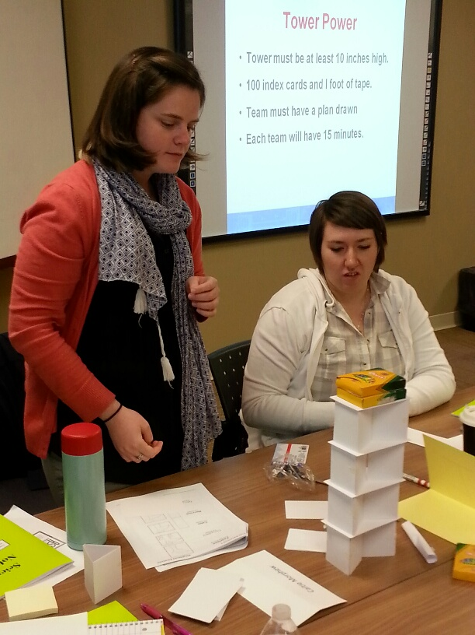
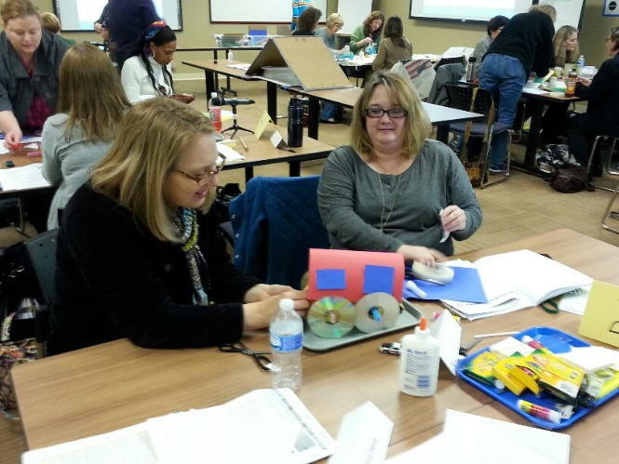
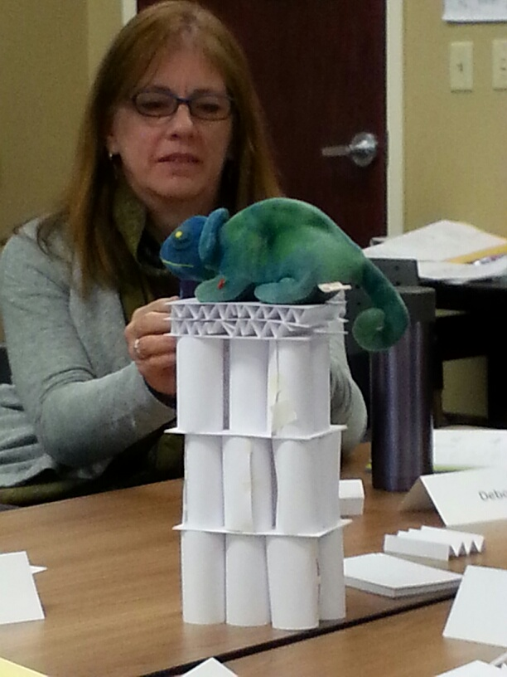
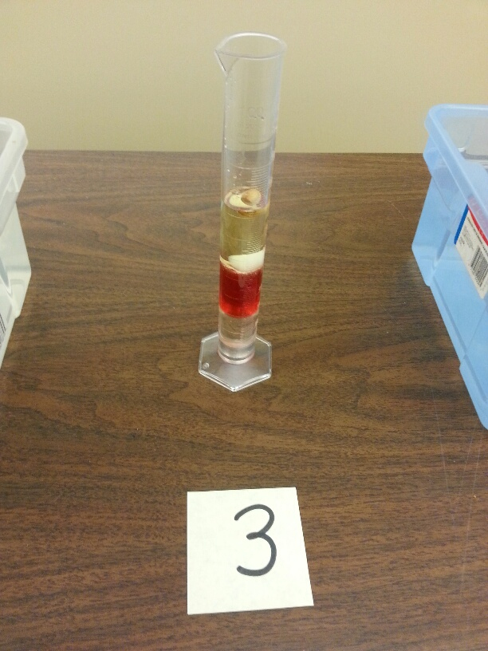
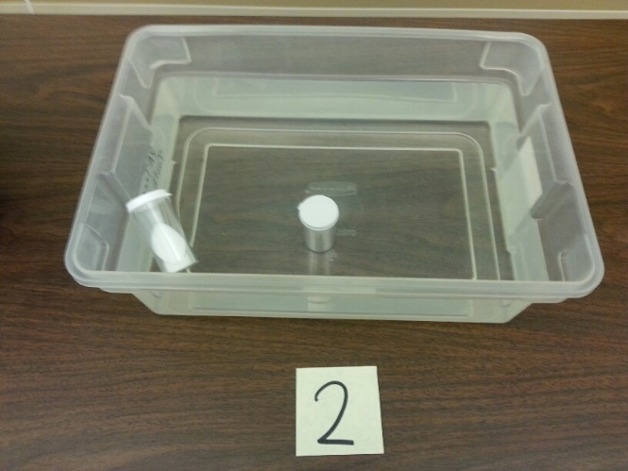
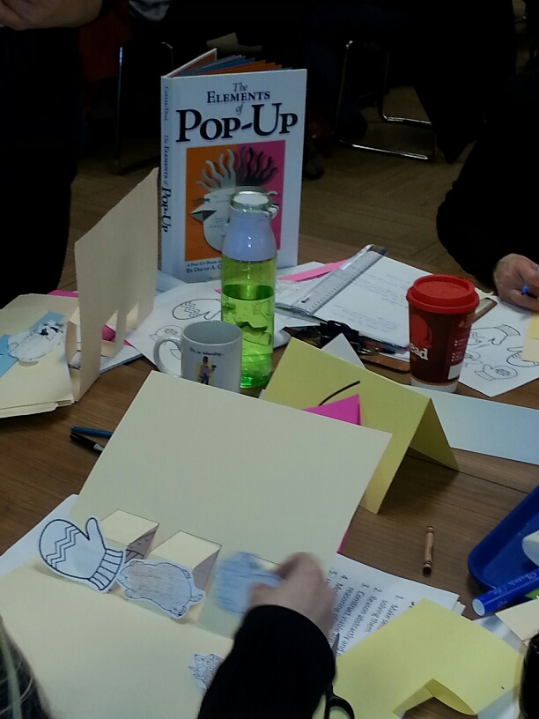
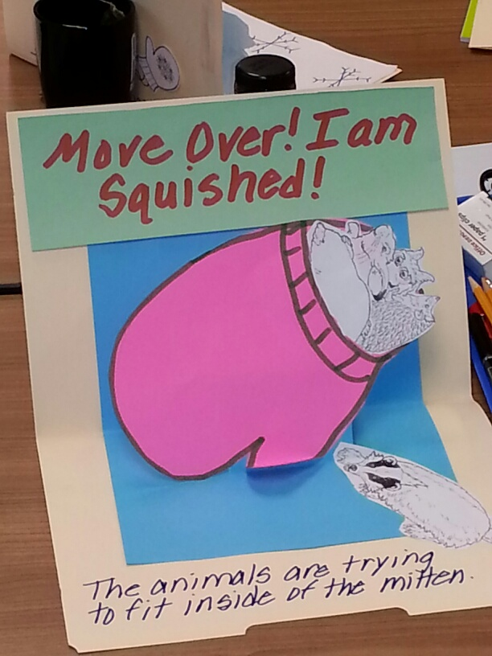
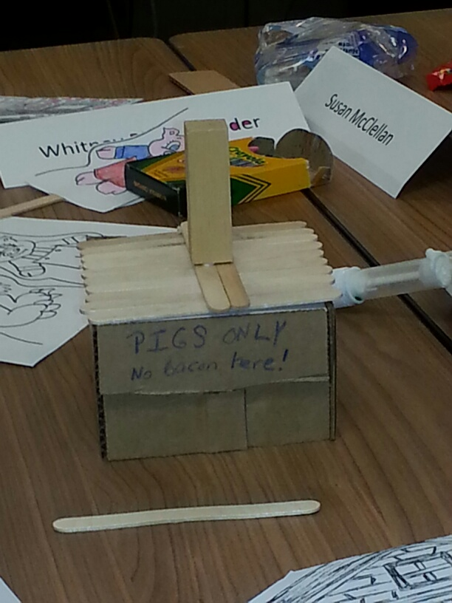
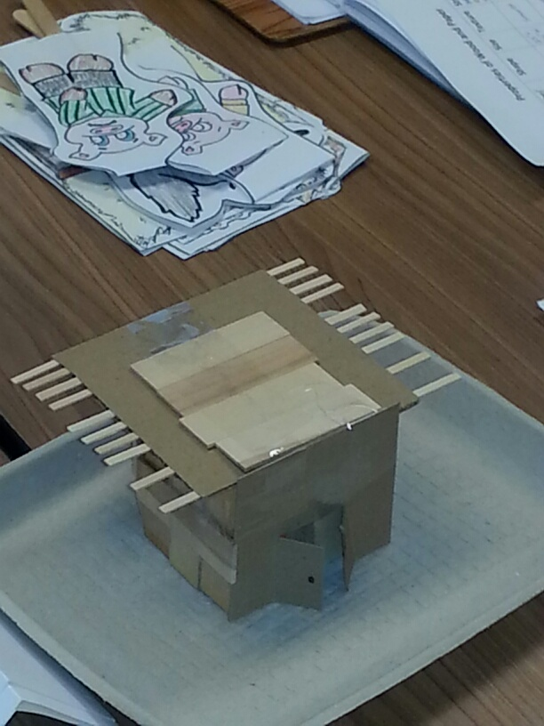
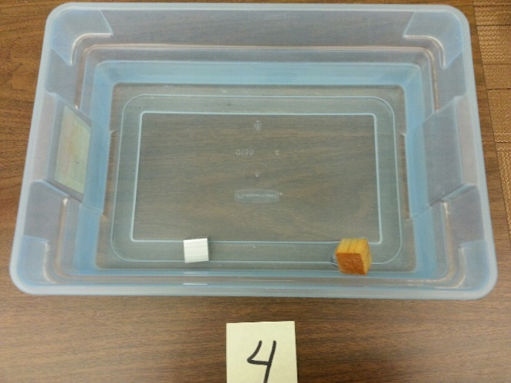
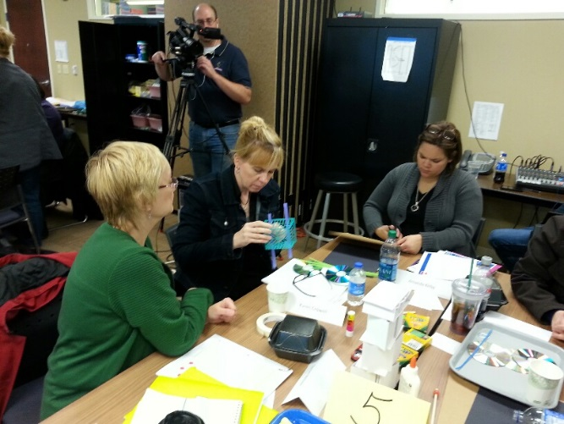
About the Librarians as STEM: Content
Notes:
[CARRIE]
In year one, the participants attended four professional development trainings that met the objectives of Goal 1 and focused on practice. Introduction to Inquiry introduced the inquiry methodology. Participants worked on various experiments and learned the necessary questions to fuel a STEM discussion with children. Go Green: Recycled Racers introduced the engineering process. Participants spent the day completing various activities to explain the engineering process culminating with the creation of a recycled racer. Science & Literacy extended the engineering process and demonstrated how to incorporate it with literacy. Participants used the Three Little Pigs as the literacy piece and conducted various activities explaining the engineering process again before culminating with the design and building of a house for the three little pigs. Pop-Up Books introduced the math standards present in the common core. Participants learned to make Pop-Up Books.
In Year 2, the participants attended two trainings that focus on building a professional learning community, discovering participant strengths and how they can better work together. Leadership Essentials prompted participants to work together to determine common STEM strengths and found buddies to visit and observe
Now in Year 3, participants will continue to strengthen leadership skills, build capacity and sustain the project by sharing what they learned through presentations and trainings such as today.

Slide 11
About the Librarians as STEM: STEM Learners
Inquiry
Engineering Design Process
Science Process Skills
Observing
Predicting
Planning and Investigating
Communicating
Questioning
Interpreting
Notes:
[CARRIE]
Not only are the participants adding inquiry and engineering design process elements to their programs but also applying the science process skills listed here. Before each session, participants completed a reflection piece about what they did/how they implemented the practice, what they learned and what their next steps are similar to what we are conducting today with the chart activities. The reflection pieces were turned in for evaluation purposes but the students also split into three groups and discuss those same questions. Just a few examples of how these topics are being used in the library programming include: the engineering design process as part of traditional gingerbread workshops and inquiry in all programs even as young as preschool using science and literacy themes with Twinkle, Twinkle Little Star and Three Little Pigs.

Slide 12
About the Librarians as STEM: Goal 2
Bridge scholastic STEM teaching and learning informed by state grade-level standards with out of school time programs for children.
Notes:
[CARRIE]
There are no STEM standards but there are science and engineering practices, in the new NGSS (Next Generation Science Standards) science standards. The participants learned math standards from PA Core Math in the Pop-Up Books Training and received links to receive more information about these standards online.
Looking to improve relationships with school partners through common language and understanding around STEM education. A letter was sent to the local school districts with participants from ACLA and ASSET. The letter did not prompt as much discussion as hoped. The libraries have worked with the schools though for after-school outreach, one of which you will hear about today.

Slide 13
About the Librarians as STEM: Goal 3
Help families to foster “life-long, life-wide, and life-deep” STEM experiences in both libraries and homes, while also involving families in programming.
Notes:
[CARRIE]
Northland Public Library, who you will hear from this morning, has created take-home science kits in pencil boxes. These small science kits include an experiment, instructions and inquiry questions for the parents to use with the children. This is an excellent way for those participants to achieve this goal.
In addition, another library encouraged the children to take the recycled racers home during the summer and finish it with their parents before returning for the next session. Obviously, that does not work for every library but it is a great way to involve families in the STEM learning process.
Finally, many of the participants have said that the parents have told them that the children are talking about the STEM learning at home after attending the program.

Slide 14
About the Librarians as STEM: The Professional Learning Community
Notes:
[CARRIE]
Another aspect of the project is the professional learning community that the participants are creating as they learn, work and eventually train and present together. This doesn’t just happen by luck it must be intentionally BUILT with everyone working together.
The first piece of the professional learning community for this group was the wiki. It was established prior to the implementation of summer reading programs. There were prompts for participants to answer and talk about what they had learned, questions they had and anything else they wanted to share, such as pictures, suggestions or program templates. It was a wonderful way to interact with the other participants virtually.
The participants also made connections with other participants to conduct a visit and watch them do a program. The person leading the program told the person watching what they wanted to learn or something they wanted to know. After the person was done, they made there recommendations about what they had seen. Although this was difficult due to scheduling, it was invaluable for the participants to watch a peer do possibly the same program. Many found new ideas to take away and apply at their own libraries.

Slide 15
Discussion
What do you want to know?
Notes:
[CARRIE]

Slide 16
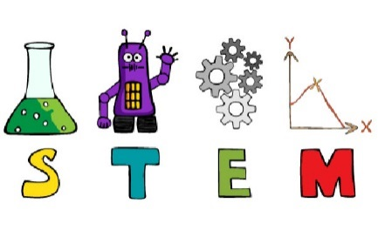
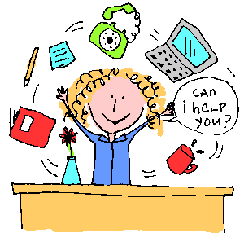
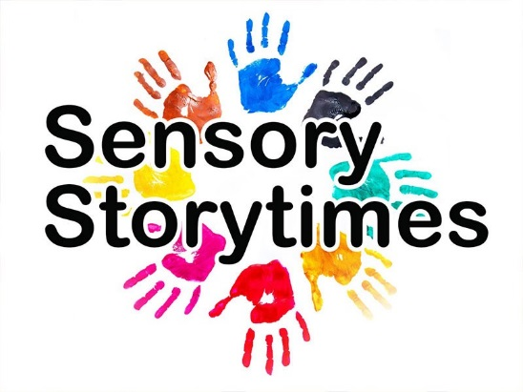
Breakout Session #1: School Age, Part 1 Kim Englert, Northland Public Library
Now that I understand inquiry, could you please tell me where I can possibly fit it into my schedule?!?
Notes:
[KIM]

Slide 17
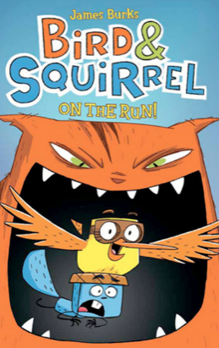
School Age, Part 1: Crazy for Comics
Crazy for COMICS
Notes:
[KIM]
Rather than adding something new to my full plate, I decided to apply the training to an existing program I was already doing. A book club(a fairly traditional library program). Mind you there wasn't anything wrong with this program. I had 4-5 kids who came every month. We had fun. I'm a graphic novel fan as are many kids. And we would do comic-making activities, book discussion, snack yadda yadda yadda.

Slide 18
School Age, Part 1: Crazy for Comics
Monthly evening graphic novel book club for 3-5th graders
Venue for artistic expression, creativity and authorship
Doodle on the table
Discuss the story, the art, and the comic-making process
Draw, make comics, or engage in other creative activities
Won a Best Practices
Devoted group of kids
Crazy for Comics has a waiting list each month now
Notes:
[KIM]

Slide 19
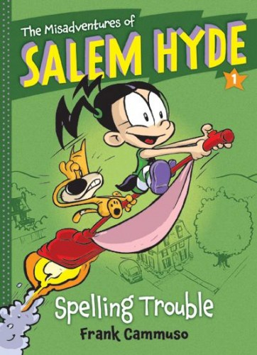
School Age, Part 1: Crazy for Comics
Egg Drop Challenge
Shopping list and a budget
Materials like cotton, paper, pipe cleaners, rubber bands, plastic bags, etc.
Come up with a design
Test it by dropping in a stairwell.
Improve it!
Notes:
[KIM]
Witch and animal companion Whammy who is afraid of heights. So after our discussion and drawing on table we did an egg drop challenge which was perfect inquiry-based activity. We drew Whammy on our eggs and their task was to protect him from a fall. Uses math, problem solving, engineering.

Slide 20
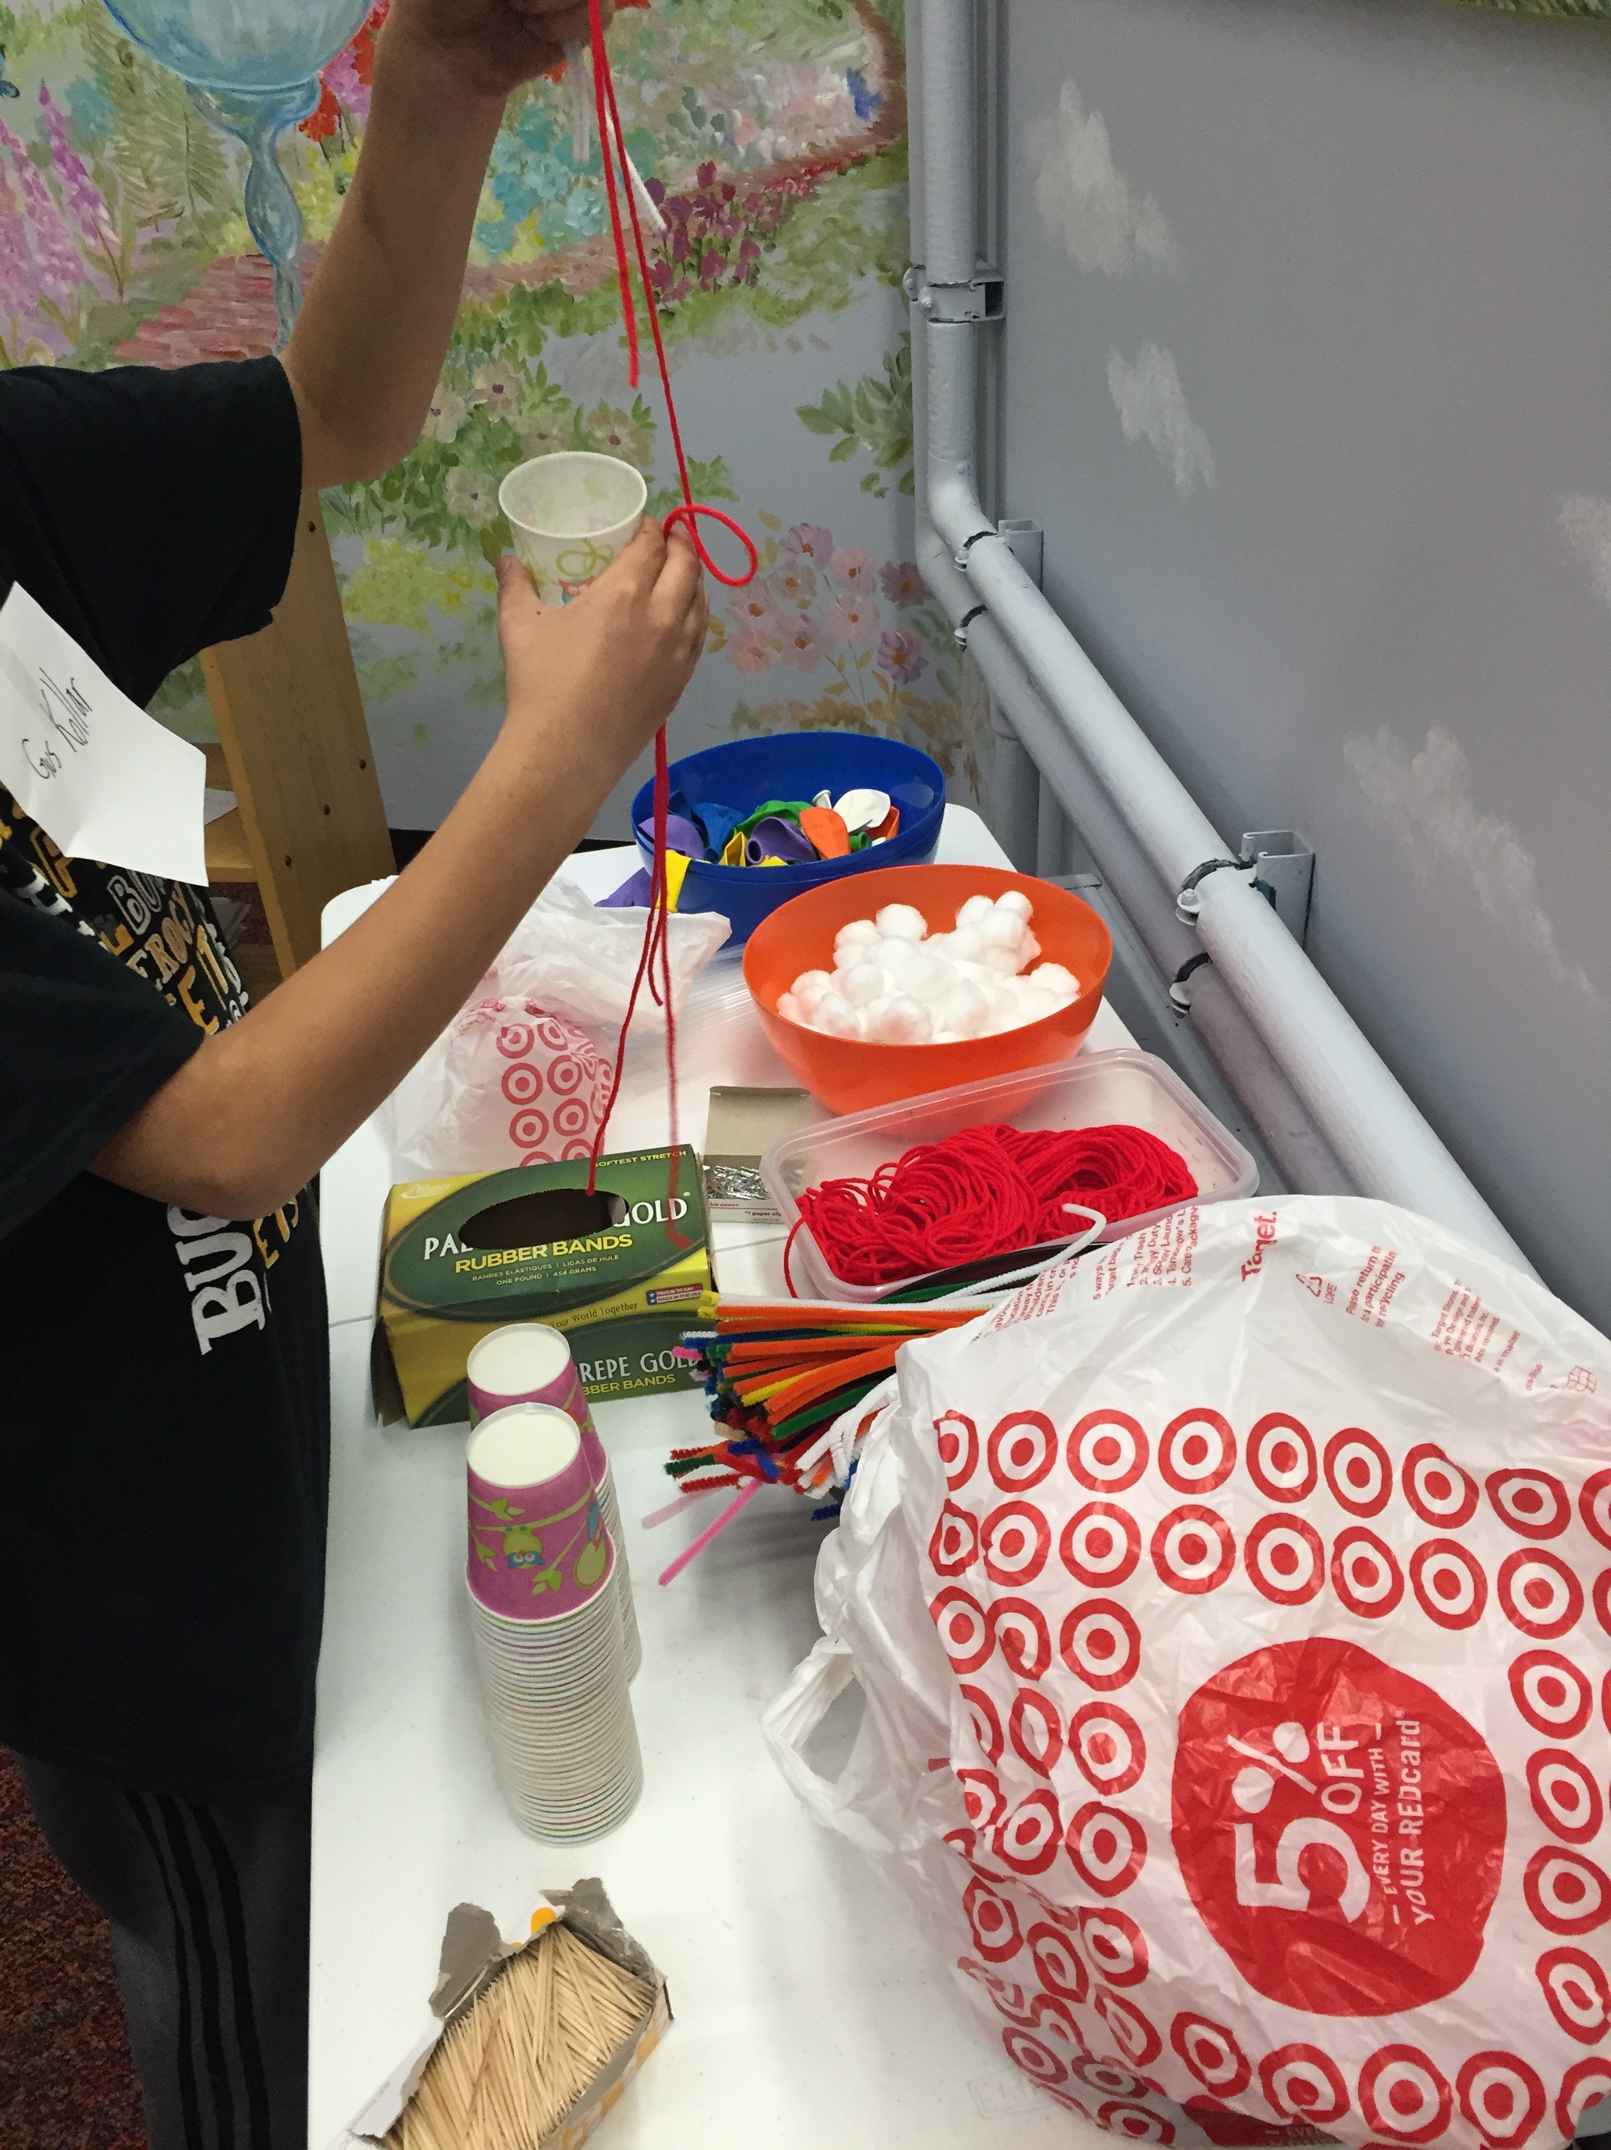
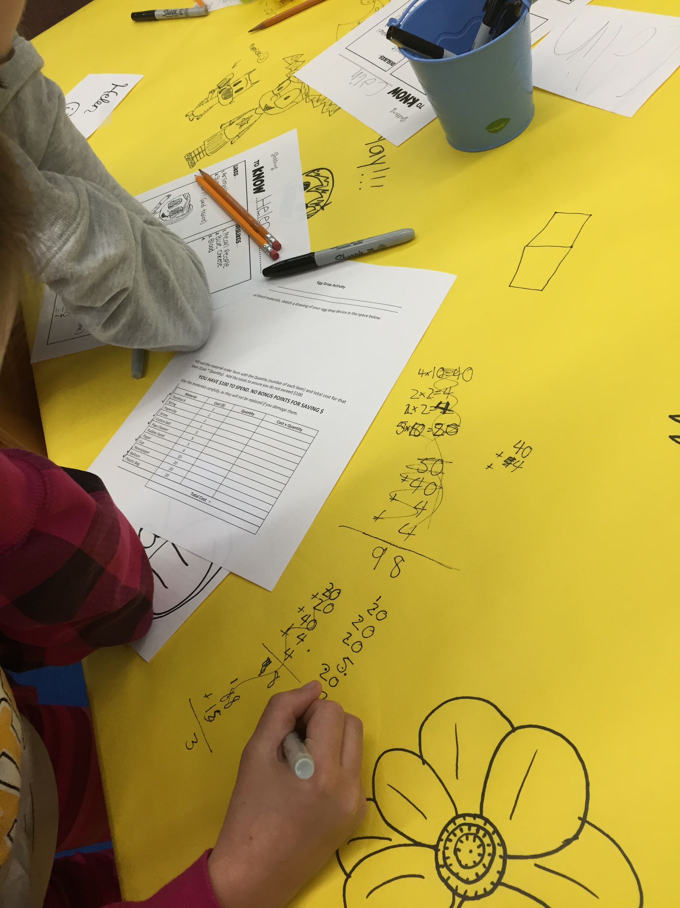
School Age, Part 1: Crazy for Comics
Notes:
[KIM]

Slide 21
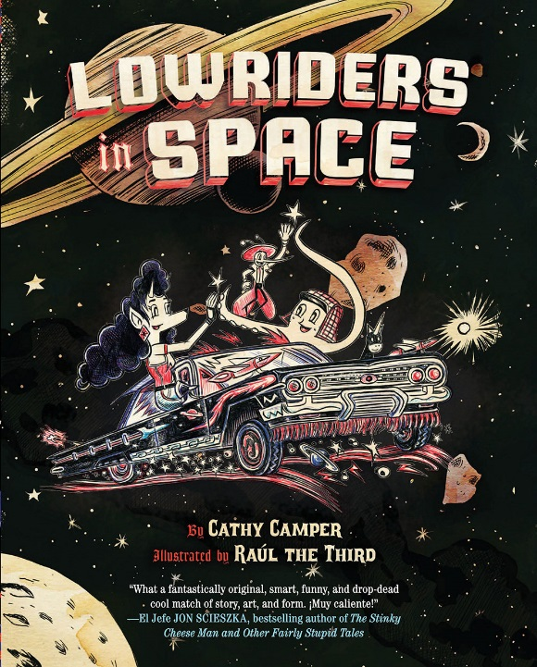
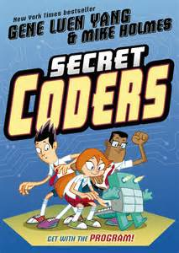
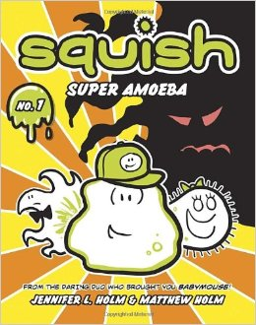
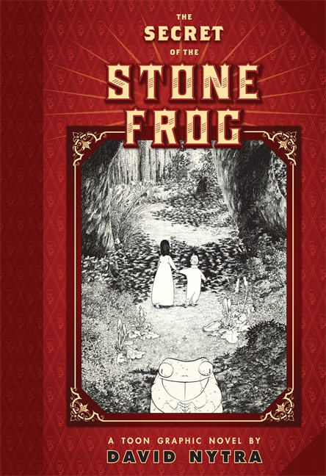
School Age, Part 1: Crazy for Comics
Recycled Racers
Squishy Circuits
Marble Runs
OzoBots
Coding Using Sphero Robots
Recycled Boats
Stuffed Animal Ziplines
Notes:
[KIM]

Slide 22
School Age, Part 1: Tips for Adding Inquiry
Don’t be afraid!
Step back!
Let the kids design, test, problem solve and improve.
Inquiry can be added to any program even those that are already successful.
Notes:
[KIM]

Slide 23
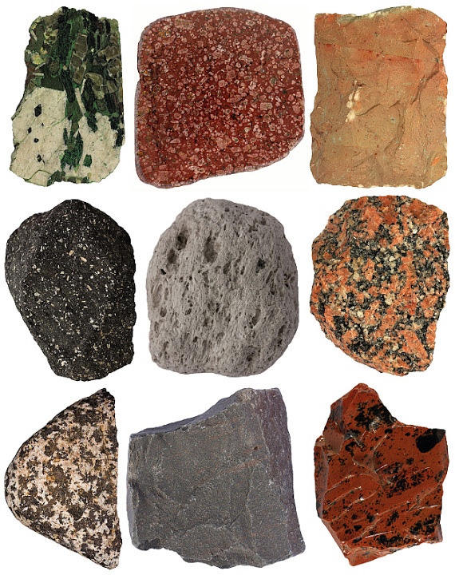
Group Activity #1: Geology Observation
Introducing inquiry
Notes:
[KIM]

Slide 24
Geology Observation: Activity Steps
Made observations “I notice”
Added scientific tool to hone observations
Formulated questions “I wonder”
Classified based on observations
Read article for information and vocabulary
Classify rocks based on evidence and observations
Notes:
[KIM]

Slide 25
Geology Observation: Facilitator’s Role
Let the learners do the learning
Provide structure
Ask questions:
What do you notice?
What do you wonder?
What happened when?
What do you think that means?
What worked? What didn’t?
What else could you try?
Notes:
[KIM]

Slide 26
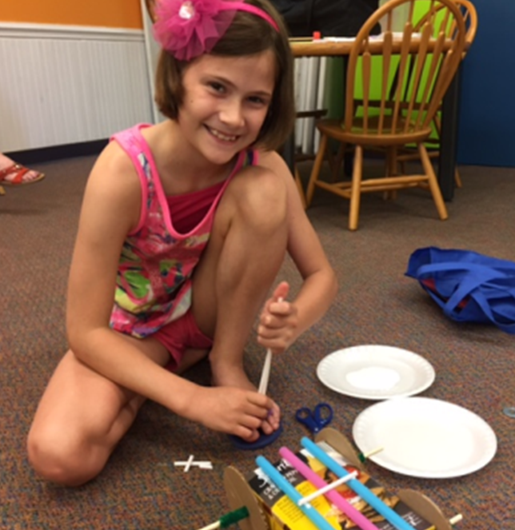
Ten-Minute Break
“The most important part of inquiry-based teaching is allowing children to formulate a question or idea, and work through the process to understand the idea. It is OK to allow children to make mistakes. It is important for children to develop thinking skills without being afraid of failure or a wrong answer. STEM is about the process.”

Slide 27
Breakout Session #2: School Age, Part 2 Courtney Bonnet, Children’s Librarian – CLP-Allegheny
Challenge: No registration? Multiple age levels? No parent present?
Building challenges work well
Plan activities with a wide age-range or easily adapted for differing abilities
Plan for space and materials
Offer alternate activities in the room
Notes:
[COURTNEY]
Scaffolding learning from one week to the next is difficult when there are no parents, no way to do registrations and there are kids from multiple age levels, abilities and interests.
__
Challenge: We are in an urban library and often when we host children’s programs, there are often no parents, no way to do registrations and there are kids from multiple-age levels, abilities, interest and comprehension. So we have to plan accordingly. We also may not see the same group of kids in a row, so scaffolding learning from one week to the next is difficult. Everything needs to be done in the one program time. Discrepant event, concept introduction, all the way through to completed activity and confirming knowledge. I have used lots of these types of building challenges. Using a variety of materials, wood blocks, Legos, magnetic tiles, straws and connectors, K’Nex, or lots of cardboard boxes and tubes. Kids of all ages can build things and use their own skills and knowledge to meet the criteria.
We plan activities that can be done with a wide age-range or adapted for differing abilities
We plan for the space and materials—if more show up we have to cap attendance or find a way to double-up or share materials
Other activities in the room—sometimes the activity won’t work for all children. I have alternate activities in the room on a similar theme. So for this activity, the theme was STEM Fairy Tales---The Three Little Pigs---I used the Three Little Pigs app on the iPads, Three Little Pigs coloring papers & story sequencing papers, I used multiple versions of the Three Little Pigs story in book form and I even had alternate wooden blocks in a corner.
STEM: Engineering with Three Little Pigs—Using the Engineering Design Process
Materials:
12 inch rulers for each group
Materials trays
Wood blocks
Cardboard
Three sets of cubes for pigs
Paper
Pencils or markers
Building Criteria & Constraints
Build a house for the three pigs
Use only the materials provided
All three pigs must fit inside
There must be a door
Won’t blow over when Big Bad Wolf blows,
Under 12 inches high
Engineering Design Process
Ask—What problem are you trying to solve? Build a house for the pigs
Imagine—What are possible ways you could solve the problem of building a house big enough for the pigs and strong enough to withstand a strong gust of Big Bad Wolf wind.
Plan-- Make a plan—draw a plan for building a house
Create—Build your
Groups build their houses—7-8 minutes. Test houses for criteria-2 minutes. Think about improving designs—1 minute.

Slide 28
Group Activity #2: Tower Power Introducing the Engineering Design Process
Notes:
[COURTNEY]
Jamie--- Introducting the Engineering Design Process with the Tower of Power
Tower of Power:
Materials Brainstorm—100 index cards needed for each group with 12 inch rulers.
These are index cards—made of paper. How can they be strong enough to build a strong tower with? ---Ask what is the problem we are trying to solve?
Build a tower over 12 inches tall that can hold up the pig.
How would you make a strong structure out of them? --Imagine
What can you do to them to turn them into a strong building material? –1 min. discussion with group. --Make a plan. With kids you would want to try and have them draw their plan, we are going to skip that step due to time constraints.
Build a Tower-Criteria & Constraints
Build a tower over 12 inches high—Create—5 minutes
Use only the white index cards
12 inches of masking tape
Must be able to support the pig.
Test group structures by setting pig on the top of each of them. Did they collapse or hold? Look at other groups designs.
Evaluate constructions and consider improvements—Improve. Improving a design or redoing a challenge based on the lessons you learned is perhaps the most important part of the learning process.
We don’t have time to do it fully here, but the success of the initial design is not the ultimate end goal. The goal is that they learned one way not to build a tower or one way that it worked. We need to embrace the idea that the tower may not work and celebrate the learning that happens.
If we get it right the first time, we have nothing to learn because we already know the answer. Failure and mistakes are the way we learn, the time when we can challenge our knowledge and be open to embracing new information.
Engineering Design Process

Slide 29
Breakout Session #3: Outreach Courtney Bonnet, Northland Public Library

Slide 30
Outreach: Challenges
Offering STEM in a portable and simple manner
Serving multiple school districts
Organizing materials
Developing school contacts

Slide 31
Outreach: Logistics
STEM based programs
Designed for daycares, preschools and schools
Ages 3-11

Slide 32
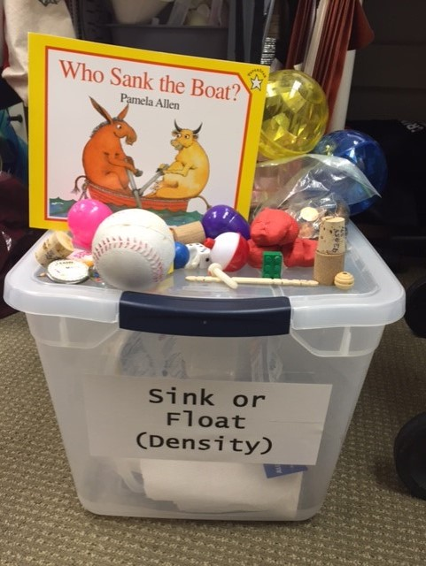
Outreach: STEAM in a box! (Sink or Float)
What is in the kit?
Book relating to the topic
Materials for a hands-on activity
Planning sheet
Hand-out for students to take home

Slide 33
Outreach: Planning
Tips for Easy Planning
Develop a planning sheet
Search Pinterest and STEM websites for program ideas

Slide 34
Outreach: Sample After School Club Schedule
Science: Gross Science (Gross things about our bodies)
Technology: Coding, Robots, Making Bristle Bots
Engineering: Tower Power Challenge, Engineering Design Process
Art: Making Plastic from Milk, Creating a Bracelet
Math: Zipline Challenge

Slide 35
Group Activity #3: Sink or Float
Introducing a concept modified for outreach

Slide 36
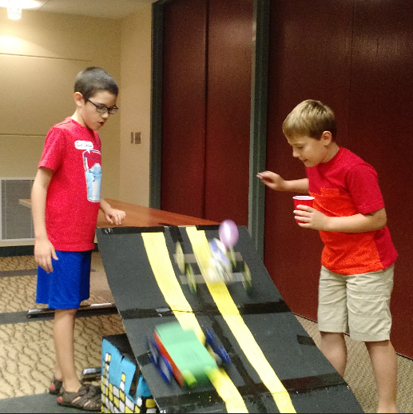
Lunch Break
“Inquiry-based science teaching is an important method of teaching through ‘hands-on’ learning and communication. Through this type of learning, the student is more involved in the learning process and as result, he or she can retain those skills more readily. In addition, this style of teaching is more fun and engaging to those who do not have a propensity to the sciences.”

Slide 37
Breakout Session #4: Family/Parent Interaction Kim Englert, Northland Public Library

Slide 38
Family/Parent Interaction: Challenges
Parents:
Complete the activity for the child
Have no interaction with the child
Want their child to complete the activity/craft just like the example
Getting the parents to understand that the process is the goal not the end product

Slide 39
Family/Parent Interaction: Logistics
Family Fun Night: hands-on STEM for families covering a variety of topics
Thursdays Under the Tree: Maker style family program, STEAM
Family Science Olympiad: hands-on experiments for families of children in K-5th grade

Slide 40
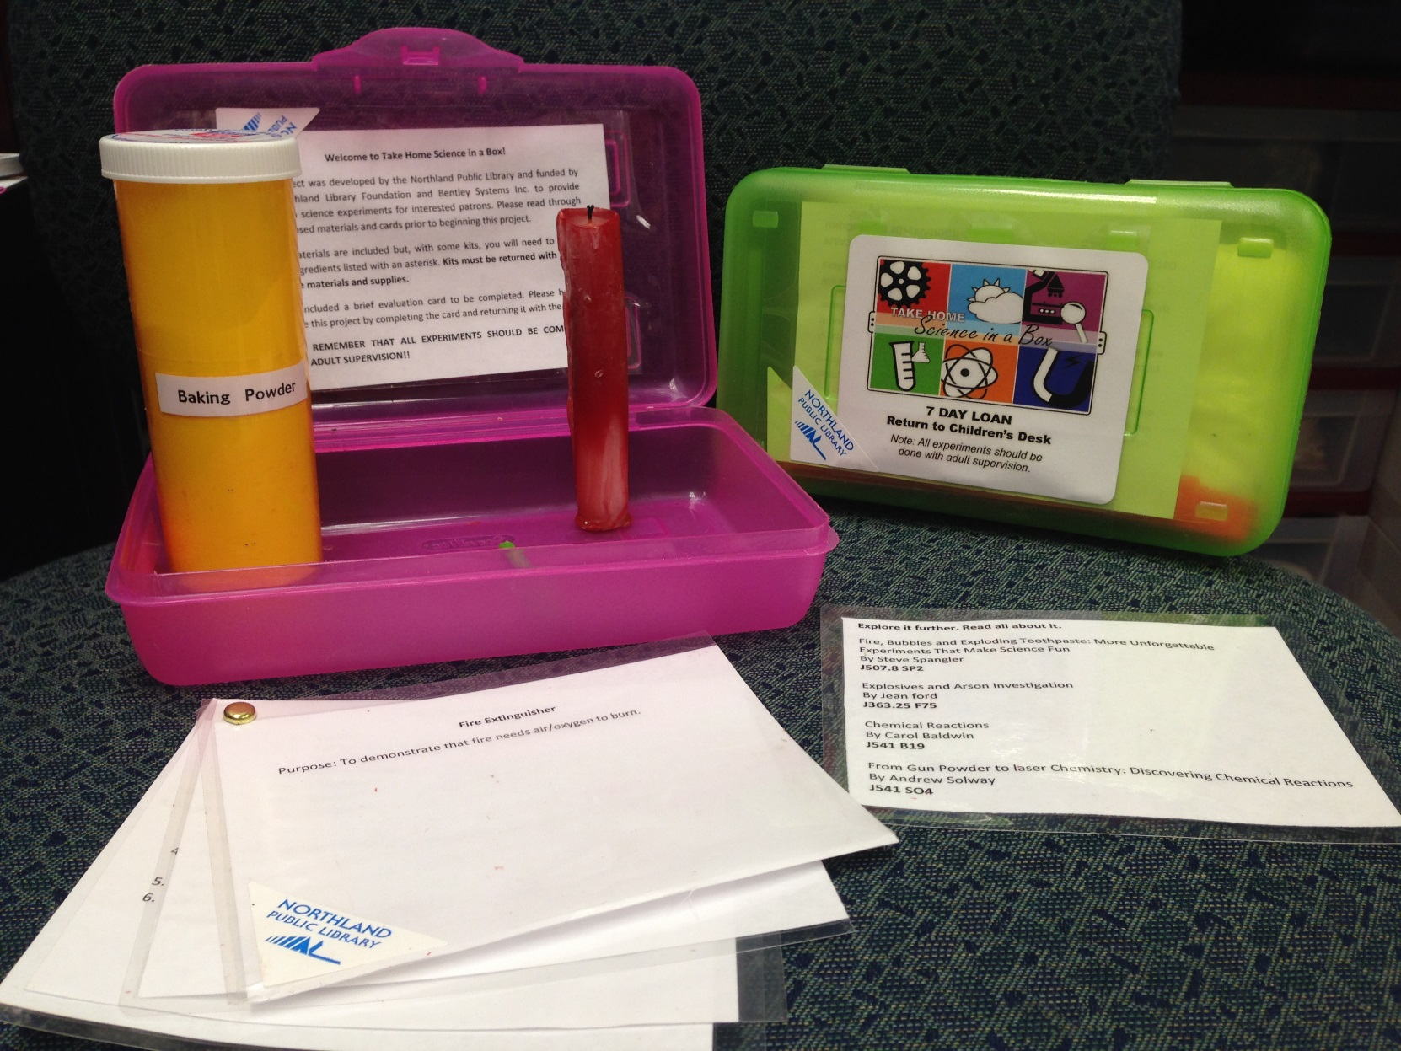
Family/Parent Interaction: Take-Home Science in a Box Kits
Kits include:
Purpose of experiment
Materials list
Procedure
Explanation
Materials not easily found at home
Reading list
Box to house kit

Slide 41
Group Activity #4: Gross Science
Introducing the topic of how to teach parents inquiry

Slide 42
Breakout Session #5: STEM in Storytime Kim Englert, Northland Public Library

Slide 43
Group Activity #5: Sample Storytime

Slide 44
Discussion
What do you know? What did you learn?

Slide 45
Conclusion
Questions?
Thank you!

Slide 46
Contact Information
Carrie Lane, Youth Services Coordinator, Allegheny County Library Association: lanec@eiNetwork.net

